Slide 1
BRAC University
Bathroom activities monitoring for older adults by a wrist-mounted
accelerometer using a hybrid deep learning model
Submitted by Tahsinul Haque Dhrubo & Ankhi Akter Mim | CSE424: Pattern Recognition

Slide 2
Overview
Major sections of this paper presentation
Introduction
Abstract
Methodology and Materials
Problem
Results
Analysis
Discussion
Conclusion

Slide 3
Monitoring activities of daily life
Evaluate health conditions for older adults
Wrist-mounted accelerometer
Six bathroom activities
Dressing, undressing, brushing teeth, using the toilet, washing face, and washing hands
Abstract
A hybrid convolutional neural network (CNN) model
MLP, SVM, KNN, DT
Cross-validation (LOSO),
f1-score for using toilet was improved from 0.7784 to 0.8437

Slide 4
Clinical relevance
This provides a model that helps monitoring older adults’ bathroom activities using a single wrist-mounted accelerometer

Slide 5
Introduction
PROBLEMS
SOLUTIONS

Slide 6
Problems
1 | 2 | 3
Age-related diseases such as cardiovascular diseases and cancers | Not concerned about activities of daily life (ADL) | Couldn't remember the activities of daily life

Slide 7
Solutions
1 | 2 | 3
Monitor and Control the diseases | Use of Deep Learning as CNN | Hybrid CNN model to recognize bathroom activities using hand crafted features and raw data from the accelerometer.

Slide 8
Data acquisition
An Empatica E4 wristband was used for collecting
data.
METHODOLOGY AND MATERIALS
Integrated with a 3-axis accelerometer, with a sampling frequency of 32 Hz and a detectable range of ±2g.
The dominant hand and annotate six bathroom activities
Six bathroom activities accounted for 49.4 hours in total

Slide 9
Signal pre-processing
Signal pre-processing included two stages: filtering and magnitude extraction
METHODOLOGY AND MATERIALS
Filtering: Two Butterworth low-pass filters were applied to the original acceleration signals
Magnitude extraction : M = root(ax2 + ay2 + az2)

Slide 10
Hand-crafted features extraction
METHODOLOGY AND MATERIALS
Features were extracted from each component, using a sliding window of 32s (1024 samples) with 50% overlap.
detailed coefficients of the third to sixth levels of the wavelet transform were included
407 features were extracted

Slide 11
Classification models
Four traditional machine learning models and two deep learning models were applied
METHODOLOGY AND MATERIALS
Support Vector Machine (SVM)
Multilayer perception (MLP) (hidden layers=3, [1:1:10])
K-nearest neighbor (KNN) (K=3, [3:2:35])
Decision tree (DT) (maximum depth=33, [1:1:35])

Slide 12
Training and testing methods
METHODOLOGY AND MATERIALS
The models were trained in two scenarios
LOSO
LOSO and transfer learning

Slide 13
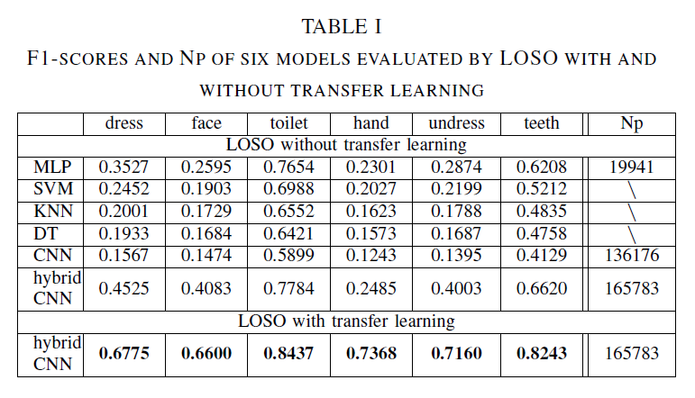
Results
Classification performance of LOSO
the f1-scores of six models based on
LOSO,

Slide 14
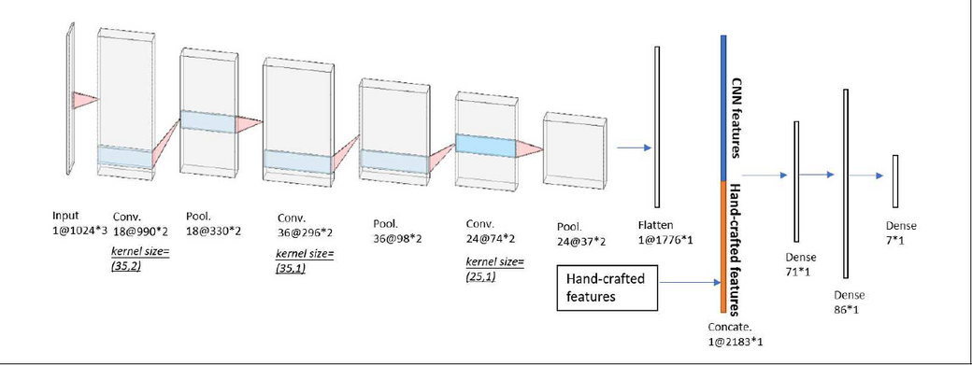
Results
Classification performance of LOSO
The hybrid CNN obtains the highest f1-scores for all bathroom activities

Slide 15
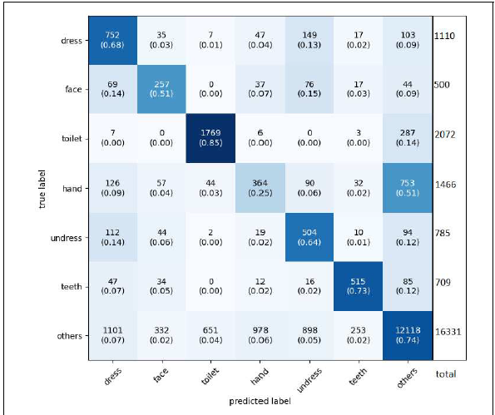
Results
Classification performance of LOSO
The main confusion occurs between others and each of six bathroom activities.

Slide 16
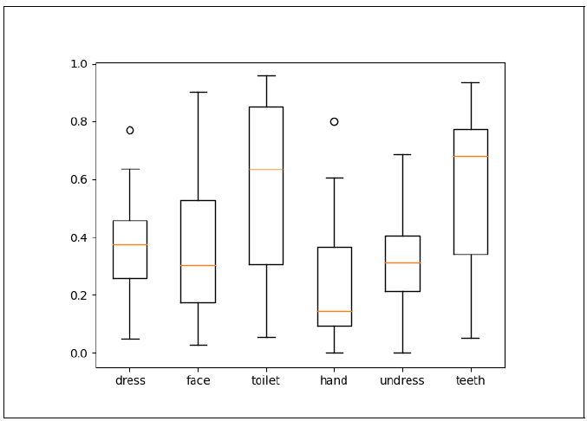
Results
Classification performance of LOSO
f1- scores for the 15 subjects using the hybrid CNN model.

Slide 17
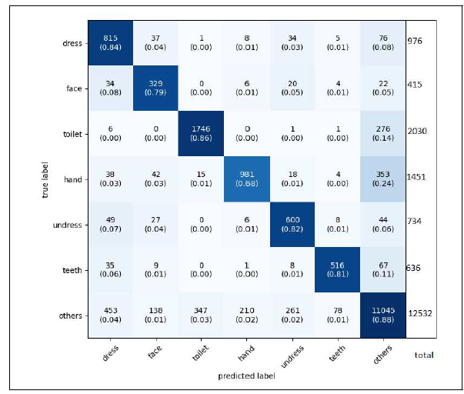
Results
Classification performance of transfer learning
The confusion matrix of transfer
learning using the hybrid CNN model

Slide 18
Discussion
Models comparison
Activity recognition
The MLP, SVM, KNN, and DT have hand-crafted features as input while the hybrid CNN model fuse the hand-crafted features and CNN-based features
This part will only discuss the activity classification results of the hybrid CNN model.

Slide 19
Discussion
Transfer learning
According to the comparison between the results of LOSO and transfer learning, the subject-dependent models show higher f1-scores

Slide 20
Conclusion
This study is aimed to recognize the bathroom activities of
older adults using a wearable accelerometer by deep learning
methods.

Slide 21
Tahsinul Haque Dhrubo & Ankhi Akter Mim
Thank you!

